Slide 1

Data Analytics Project Automobile Market Analysis
Presented By- Tamanna Dagar

Slide 2

Project
Overview
Business Problem
The automobile resale market generates a large volume of transaction data every day. Businesses need to understand pricing trends, customer demand, seller performance, and factors affecting resale value to make informed decisions.
Project Goal
Develop an end-to-end analytics solution to identify pricing trends, evaluate market performance, and generate actionable business insights using Python, SQL, Statistics, and Power BI.

Slide 3
Project Objectives
Clean and preprocess the automobile dataset.
Improve data quality using feature engineering.
Analyze pricing trends and market performance.
Validate business assumptions using statistical testing.
Perform business analysis using SQL.
Build interactive Power BI dashboards.
Generate strategic business recommendations.

Slide 4
DataSet Overview
Dataset Size
Approximately 5,58,837 Vehicle Records
Major Attributes
Make
Selling Price
Model
Year
Body Type
Transmission
Seller
State
Odometer
Vehicle Condition
Sale Date
MMR
Engineered Features
Vehicle Age
Price Difference
Price Ratio
Sale Month
Sale Quarter
Sale Weekday

Slide 5
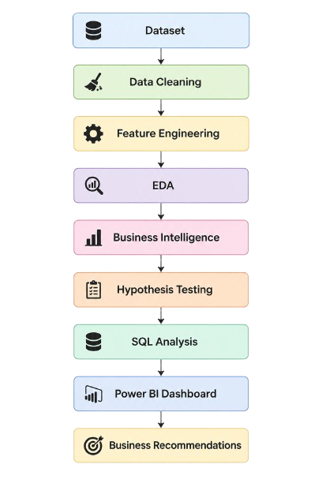
Project Workflow

Slide 6
Data Cleaning & Feature Engineering
Data Cleaning
Missing Value Handling
Duplicate Removal
Data Type Conversion
Outlier Detection
Data Validation
Feature Engineering
Feature | Formula
Vehicle Age | Sale Year − Manufacturing Year
Price Difference | Selling Price − MMR
Price Ratio | Selling Price ÷ MMR
Sale Month | Month(Sale Date)
Sale Quarter | Quarter(Sale Date)
Sale Weekday | Weekday(Sale Date)

Slide 7
Exploratory Data Analysis
Exploratory Data Analysis
Visualizations Used:
Distribution Analysis
Boxplots
Correlation Heatmap
Monthly Sales Trend
Brand Analysis
Seller Analysis
Geographic Analysis
Vehicle Condition Analysis
Key Findings
Automatic transmission dominates sales.
SUVs and Sedans have the highest sales volume.
Strong variation exists across brands and states.
Selling price is closely related to MMR.

Slide 8
SQL Business Analysis
SQL Business Intelligence
KPIs Generated
Total Revenue
Total Vehicles
Average Selling Price
Average MMR
Business Queries
Top Brands
Top Sellers
Revenue by State
Monthly Sales
Premium Vehicles
Body Type Analysis
Transmission Analysis
Seller Ranking

Slide 9
Power BI Dashboard
Page 1 Executive Dashboard- This dashboard provides an executive summary of the overall automobile resale market.
Page 2 Pricing & Resale Value Analysis- This page focuses on pricing behavior and resale value compared with market benchmarks.
Page 3 Vehicle performance & Market Intelligence- Here we analyze how vehicle characteristics influence resale prices.
Page 4 Seller & Geographic Intelligence- This dashboard highlights seller performance and regional market trends.
Page 5 Executive Insights & Business Recommendations- The final page summarizes key business insights and strategic recommendations derived from the complete analysis.

Slide 10

Key Business Insights
Key Findings
Approximately 559K vehicles analyzed.
Vehicles sold approximately $158 below MMR on average.
Automatic transmission dominated the market.
Mercedes-Benz, BMW, and Lexus achieved the highest average selling prices.
Vehicle age and mileage reduce resale value.
Better vehicle condition increases resale value.
Florida and California showed strong premium vehicle demand.

Slide 11
Business Recommendations
Recommendations
Increase inventory of low-mileage vehicles.
Expand premium inventory in high-demand regions.
Use MMR as the pricing benchmark.
Improve inventory planning using analytics.
Focus marketing efforts on premium markets.
Promote well-maintained vehicles to maximize resale value.

Slide 12
Technologies Used
🐍 Python
🗄 SQL
📈 Statistics
📊 Power BI
📉 Data Visualization
🔍 EDA
💼 Business Intelligence

Slide 13
Thankyou

